Slide 1
Survey analysis week 7 “ratio and regression estimation”
© Peter Lugtig

Slide 2
Today
Why ratio estimation?
Class exercise ratio estimation
New example: coffees at UU
Lecture ratio and regression estimation
Class exercise regression estimation

Slide 3
First rewind to cluster sampling….
You would like to estimate:
The number of “ whatsapp scams in Germany”

Slide 4
Cluster sampling in Germany
411 Kreise (in 2022)
Sampling frames only available at level of Kreise
Select k clusters (50)
Stratify?
Select households in clusters
Size=1500 per cluster
Two-stage cluster samples
Can we do better?

Slide 5
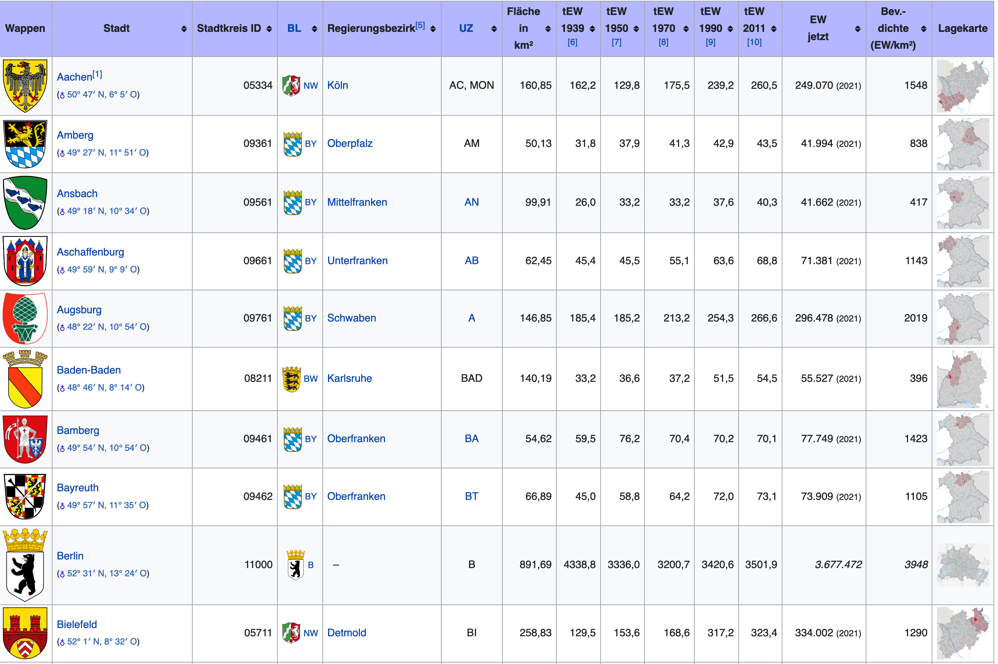
Size of clusters is known

Slide 6
Estimate at cluster level
Imagine we select Aachen
We draw an SRS of 2.000 households
Conduct the survey: 1.000 households participate
We find that 12 people were victim of Whatsapp fraud last year
What is the total number of Whatsapp frauds in Aachen?
Number of individuals: 2123
12/2123 = .56% of individuals
Number of individuals in population = .0056 * 249070 = 1394

Slide 7
Our entire Sample
Aachen
Mean Population size = 235509
Mean whatsapp fraud = 1307
Ratio = 180/ 1
Or .00555 of population
Germany: population is 83 Million
Whatapp fraud is 83M/180 = 461k

Slide 8
Why ratio estimation?
We know:
The size of each farm in the USA
N_{h} and n_{h}
Estimate from a sample:
What crops they produce
What is their yield per acre (or total production)
USA wheat production = wheat production per acre * total # acres of wheat
Auxiliary information at level of farm

Slide 9
Why ratio estimation?
We know:
How many schools there are: # schools
N_{h} (no. of clusters)
Estimate from a sample:
The average number of children per school: n_{h}
the proportion with reading problems: p
Total # children with learning diff = n_{h} * N_{h}* pchildren with reading problems or
Auxiliary information at level of cluster

Slide 10
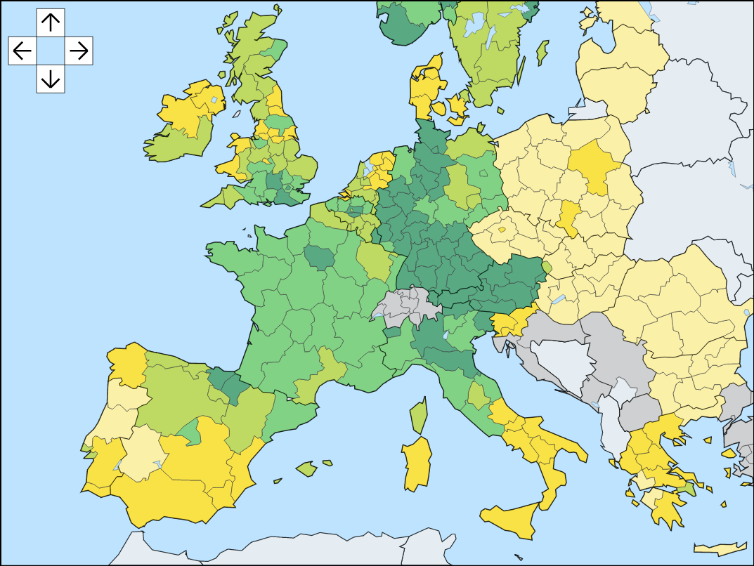
Why so often in cluster samples?
We often don’t know much about individuals
But we do know about the clusters
Public sources:
Population size
income, employment
Gender, age distribution
Etc.
Is Y strongly correlated with these?
And a ratio variable?
Ratio estimation
E.g. No. of births, marriages, death

Slide 11
Class exercise 1
25 minutes
4 questions…

Slide 12
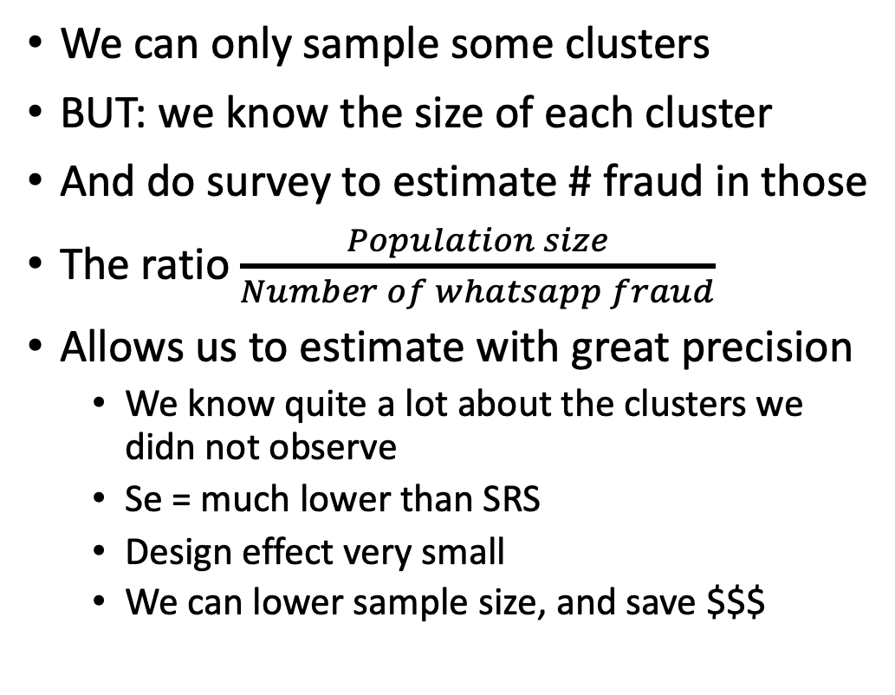
What is great in ratio estimation
We can only sample some clusters
BUT: we know the size of each cluster
And do survey to estimate # fraud in those
The ratio $\frac{Population size}{Number of whatsapp fraud}$
Allows us to estimate with great precision
We know quite a lot about the clusters we didn not observe
Se = much lower than SRS
Design effect very small
We can lower sample size, and save $$$

Slide 13
What more is there?
Estimating fraud in every cluster
Berlin: population 3.7 million. Whatapp fraud 3.7M / 180 = 20558
Ansbach: population 41k. Whatsapp fraud 41k/180 = 228
We can now using a model to predict fraud in every council

Slide 14
What is a problem in ratio estimation
Question 4: class exercise
There may be bias!
Outlier clusters
Large cities drive results
Whatsapp fraud may be local
Population size = 0 doesnt happen, but whatsapp fraud = 0 does!
The origin does not really exist

Slide 15
What about making the model more complex?
What about including other covariates?
Urban/rural
Average income of cluster
State of the council
Etc.
We build a regression model
More covariates
Why not an intercept?

Slide 16
Model-based estimation
Using a survey from some clusters….
We try to predict Fraud in other clusters
And the sum of all predictions is the total

Slide 17
Class exercise 2
Regression estimation in practice
30 minutes

Slide 18
Design-based versus model-based
Variance of the estimator:
Design-based:
Average squared deviation of the estimate and the expected value,
averaged over all possible samples under the sampling design
(i.e. we repeat the sampling procedure 10000 times, and estimate variance in the total)
Model-based
Average squared deviation of the estimate and the expected value,
averaged over all possible samples under the model
(i.e. we assume the model is correct, and sample 10000 times new observations, fit the regression line, and estimate variance in total)

Slide 19
When ratio vs. regression?
Ratio
Size of area/no. of buildings -> people in a certain area
Turnover per company/no. of peppers -> total pepper production
Often, good frame information, and a meaningful 0
Regression
Happiness <- grades:gender:income:sociallife
Vote <- race:age:gender:education
Fraud <-population:urban:incomes
Often, little good frame information, no meaningful 0

Slide 20
Implicationss of going model-based
Sampling is not so important!
We just get data, and as long as we are confident that our model is correct in the population, we are fine…
We need a good (regression) model for Y
We need to worry about sample <-> population
On a more conceptual level, not about inclusion probabilities
Sample should capture variation
Selection bias, nonresponse
From now on: more focus on model-based inference
Nonresponse model -> weights
Missing data model -> imputation
Selection bias model -> ???

Slide 21
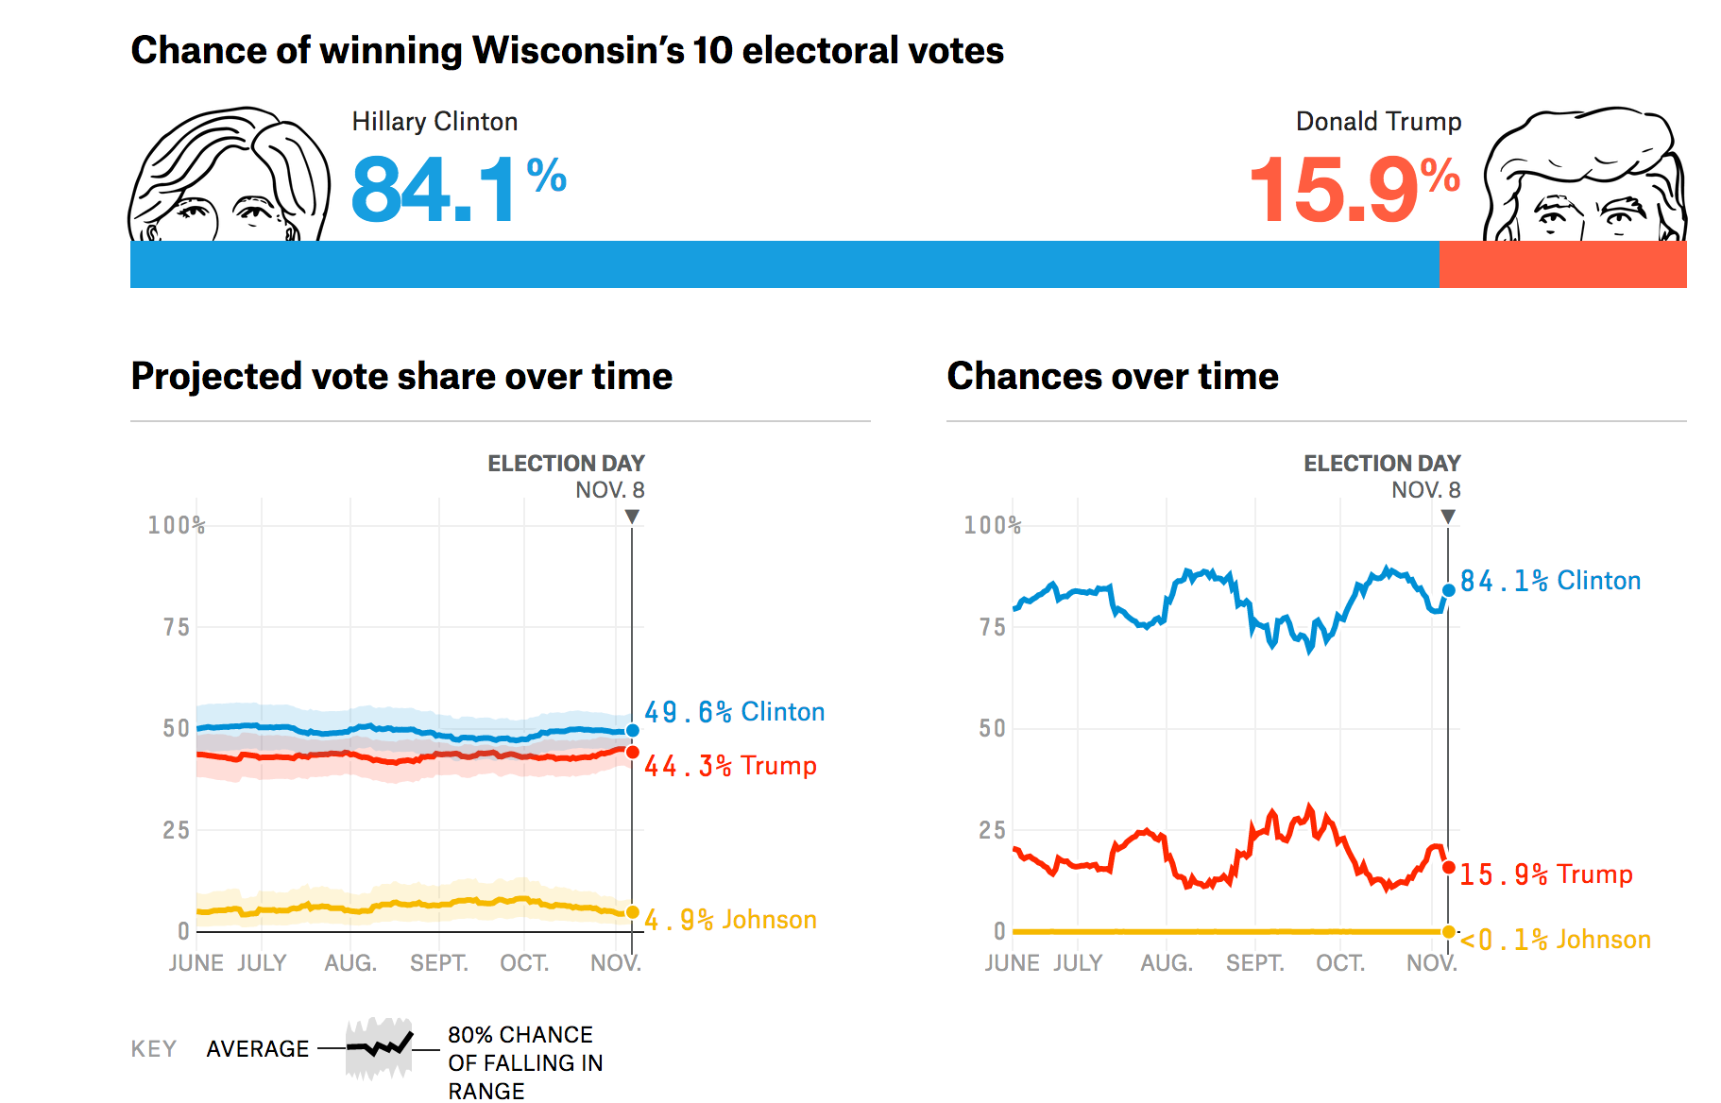
Model-based inference – an example
How did it end?
Notes:
Taken from https://projects.fivethirtyeight.com/2016-election-forecast/wisconsin/

Slide 22
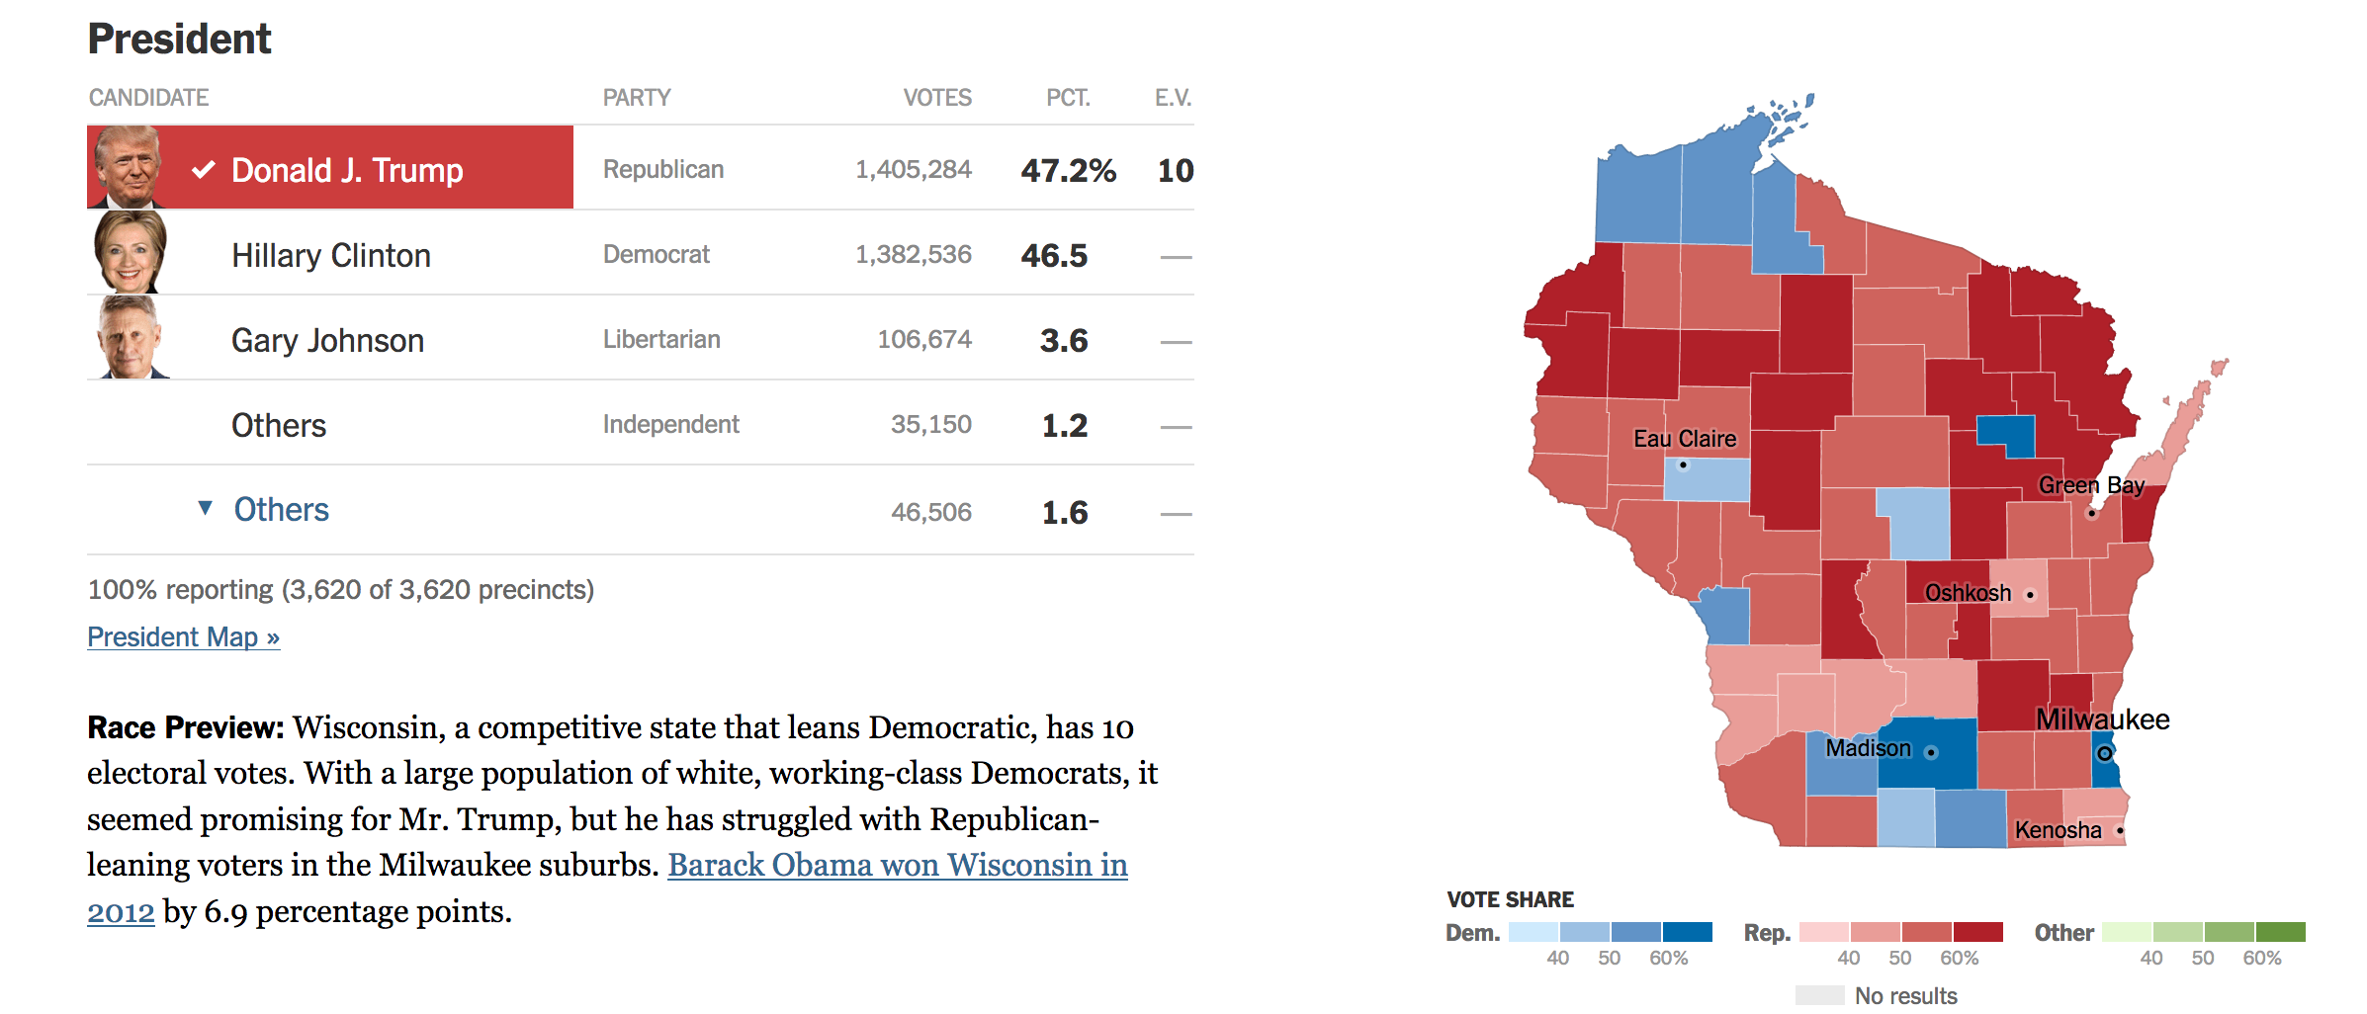
Wisconsin – Presidential election 2016
Notes:
From: https://www.nytimes.com/elections/results/wisconsin

Slide 23
Model-based inference – an example
If this were an individual poll of n=10000
s.e. =
= sqrt(.496(1-.596)/10000) = .005
Clinton Vote CI:
[.4904 - .5096]
Notes:
Taken from: https://projects.fivethirtyeight.com/2016-election-forecast/wisconsin/

Slide 24
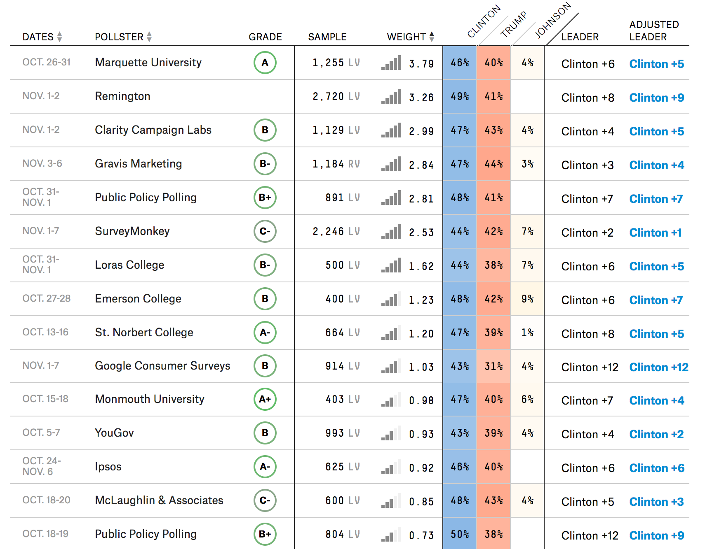
How does political polling in the USA work?
Multiple polls
Weighted by:
Quality of organisation (grade)
Recency
Results presented is aggregated total

Slide 25
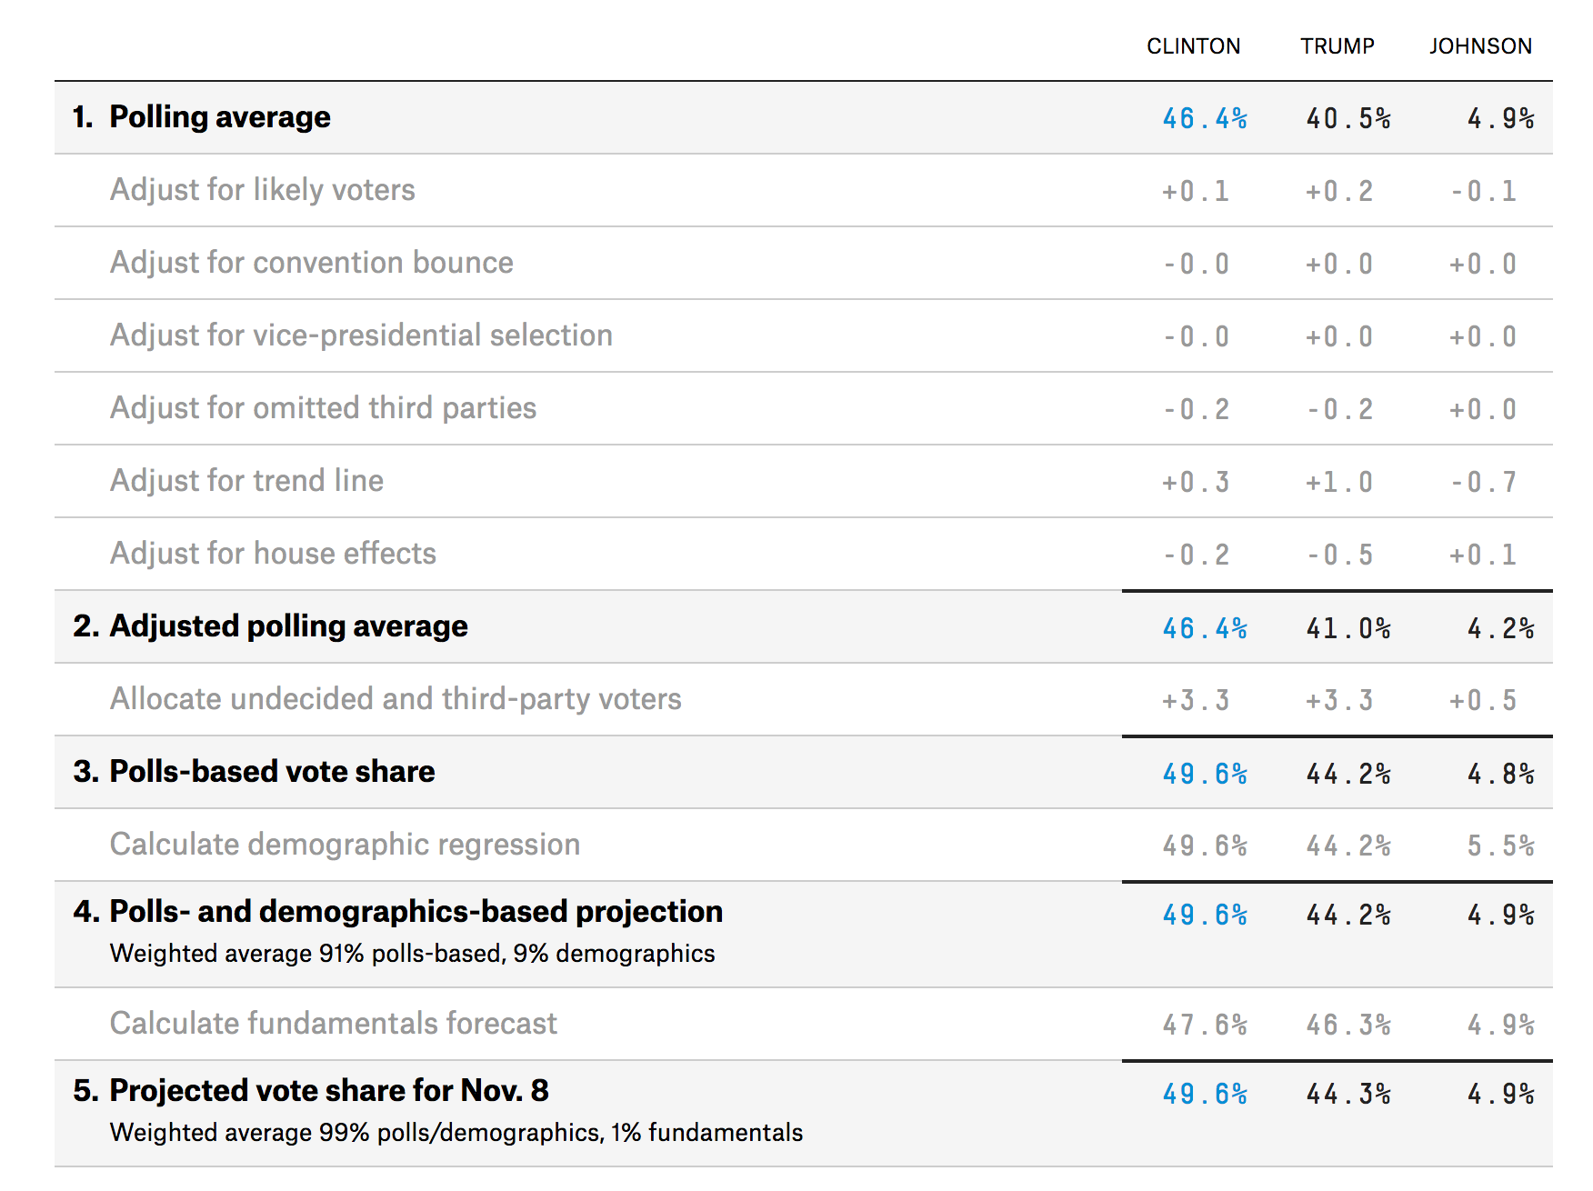
But forecasters do not stop there…
Adjustments for:
Likely voters
Not all people are likely to go and vote
Omitted third parties
Not all polls ask for all parties
Adjust for trend line
A smoothing adjustment to avoid large fluctuations
House effects
Some pollsters are known to have a bias
Notes:
Taken from: https://projects.fivethirtyeight.com/2016-election-forecast/wisconsin/

Slide 26
But forecasters do not stop there…
Adjustments for:
Undecideds
Assumption about how “don’t know” answers will vote
Notes:
Taken from: https://projects.fivethirtyeight.com/2016-election-forecast/wisconsin/

Slide 27
But forecasters do not stop there…
Demographic regression
Use data from other states:
Fit a model with demographics
(ethnicity, age, college degree, income)
What is predicted vote in Wisconsin?
Mix the poll outcome with model-based outcome
Notes:
Taken from: https://projects.fivethirtyeight.com/2016-election-forecast/wisconsin/

Slide 28
Why were the polls wrong?
It wasn’t all the modeling…..
Polls only: 46 vs. 40 – result: 46.5 vs. 47.2
+ modeling: 49 vs. 44
AAPOR report (Kennedy et al, 2017) – week 1
Shy Trump vote
Low turnout
Late swing to Trump
Failure to correct for overrepresentation of highly educated
Notes:
https://www.nytimes.com/2017/05/31/upshot/a-2016-review-why-key-state-polls-were-wrong-about-trump.html
http://www.aapor.org/Education-Resources/Reports/An-Evaluation-of-2016-Election-Polls-in-the-U-S.aspx

Slide 29
Why were the polls wrong?
Model based estimation depends on quality of model!
In design based, we can estimate error
In model-based -> much more difficult
Why not do design-based inference?
Costs
Time
Problems with coverage, nonresponse
-> still needs modeling
There are too many people who want to do a a poll
100s in Wisconsin alone
Notes:
https://www.nytimes.com/2017/05/31/upshot/a-2016-review-why-key-state-polls-were-wrong-about-trump.html
http://www.aapor.org/Education-Resources/Reports/An-Evaluation-of-2016-Election-Polls-in-the-U-S.aspx

Slide 30
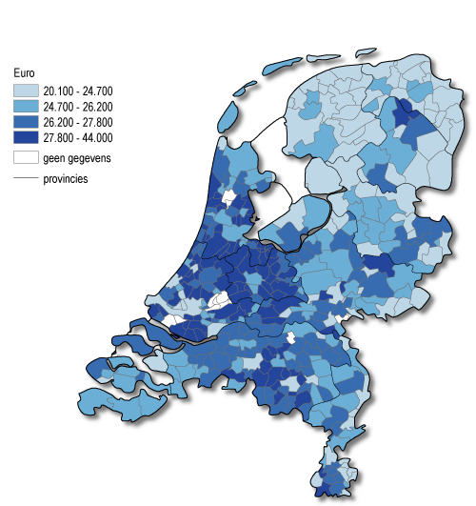
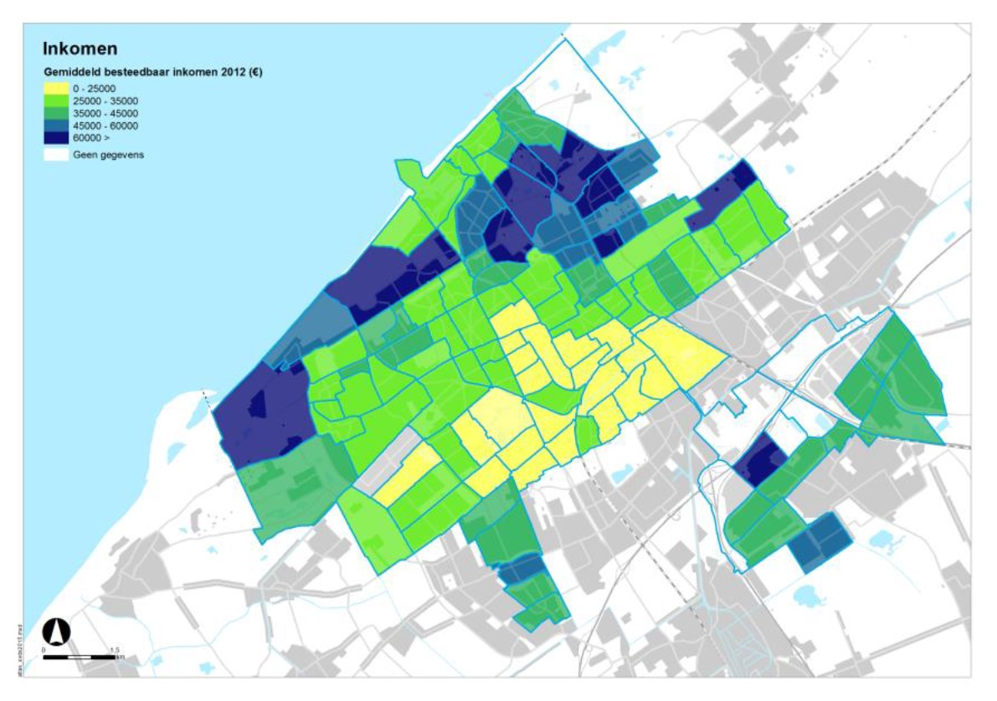
What is a cluster?
What size should be a cluster be?

Slide 31
Small Area Estimation
Desire for detailed statistics at low geographical level.
Would result in 1000s clusters in Netherlands, even more in Europe
Solution: Small area estimation
Analogue to coffee machines example
There are 100s of machines at UU
Build an elaborate model with many
auxiliary variables
Predict Y in every cluster by using a model

Slide 32
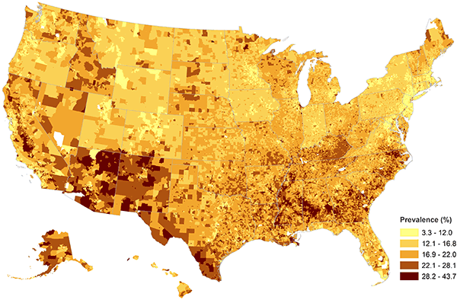
Example
Childhood obesity
Used 91,642 completed interviews from NCSH survey:
Model for every county:
NSCH child obesity status (yes or no) = sex + age + race (individual level)
+ median household income + lifestyle classifications + urbanization levels (zip-code level)
+ median household income + urban-rural (county-level)
+ random effects (state- and county-levels)

Slide 33
Next week(s)
Next week: class free
Finish regression exercise
Catch up on reading
In two weeks: nonresponse
Readings: several articles
Next friday: assignment 1 (!)

Slide 34
Extra slides
What goes right and wrong?

Slide 35
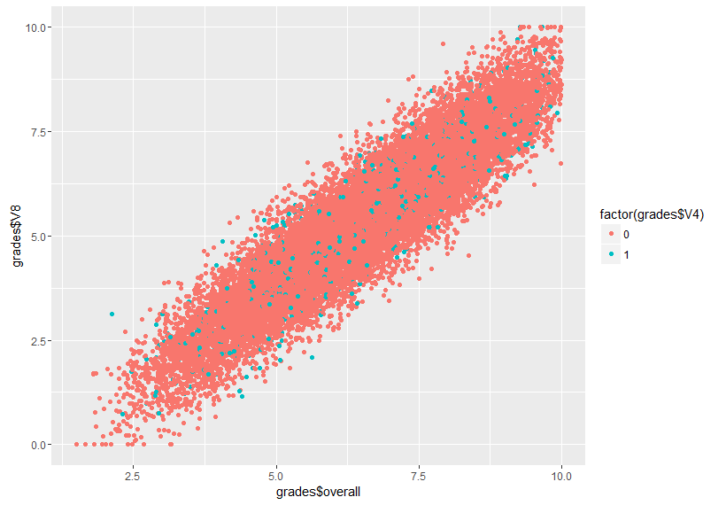
Model based sampling
Let’s bring student happiness in!
Population data:
- N=20000
X = grades
Y = student happiness (also 0-10 scale)
Mean happiness = 5.37

Slide 36
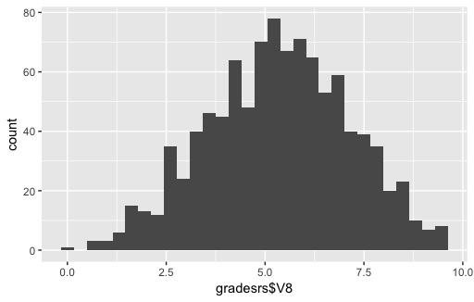
Simple Random Sampling
- Simple Random Sample
n=1000
Happiness (on X):
Mean = 5.32
S.e = .05477
CI: [5.21; 5.43]

Slide 37
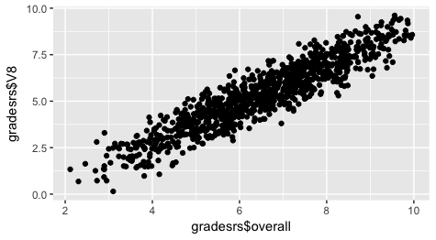
Ratio estimation under SRS
Svyratio(~happiness, ~grades, design = ratio.design)
B= .8231
s.e. = .0024
Predicted mean= 5.34
Or: summary(lm(happiness~0+grades,data=gradesrs, subset=(V4==1)))
Mean(data$fittedvalues )
B = .83
s.e. =.0036
Predicted mean = 5.42

Slide 38
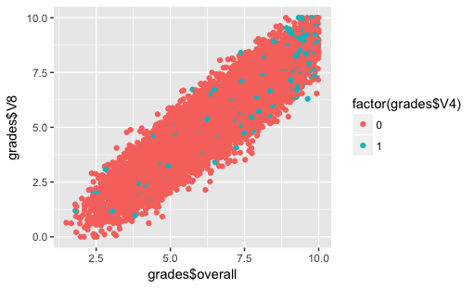
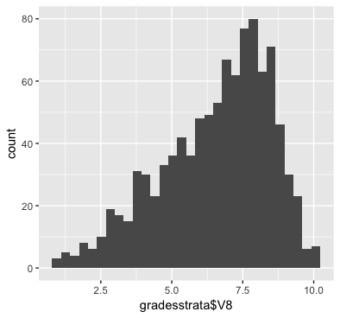
Oversample students who get good grades

Slide 39
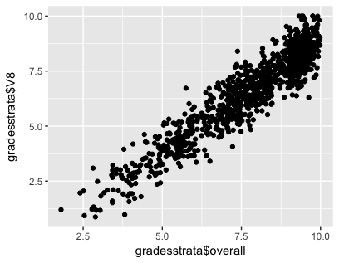
Oversampling students with good grades
Design based:
Mean = 5.33
S.e. = .0337
Ratio estimation
B=.87
S.e. = .0026
Mean= 5.335
Regression estimation
B = .83
S.e. = .0036
Mean=5.45

Slide 40
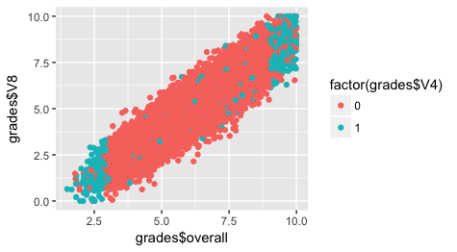
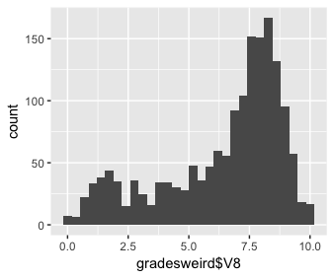
Truly model based – extreme cases

Slide 41
Truly model based – regression
Regression model:
Happiness <- grades + programme
(+ age, gender, etc.)

Slide 42
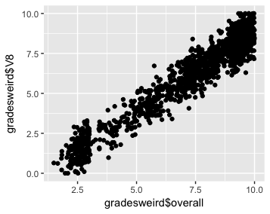
Truly model based
Design based
Mean = 5.33
S.e. = .0335
Ratio estimation
B=.87
S.e. = .0026
Mean= 5.33
Regression estimation
B = .87
S.e. = .0027
Mean=6.28

Slide 43
What works?
 | Type of sample | Mean | Precision | Mean square error
Design Based | SRS | 5.32 | .0548 | .05² + .05 = .0525
 | Oversample good students | 5.33 | .0337 | .04² + .03= .0353
 | Extreme cases | 5.33 | 0.335 | .04² + .03 = .0351
Ratio-estimation | SRS | 5.34 | .0027 | .03² + .0027 = .0036
 | Oversample good students | 5.335 | .0026 | .035² + .0026 = .0037
 | Extreme cases | 5.335 | .0026 | 035² + .0026 = .0037
Regression estimation | SRS | 5.42 | .0036 | .05² + .0036 = .0061
 | Oversample good students | 5.45 | .0027 | .08² + .0027= .0091
 | Extreme cases | 6.28 | .0036 | .93² + .0036 = .8685
Notes: Population mean = 5.37. MSE = bias + se²

